Slide 1
Effect of Local Weather Conditions on Sky Brightness
Vayujeet Gokhale, David Caples, Jordan Goins, Ashley Herdman, James Tompkins & Emily Wren
Truman State University & Moberly Area Community College
MARAC Conference 2019
The thing’s hollow. It goes on forever, and. oh my God.
It’s full of stars!

Slide 2
Talk Outline
Light Pollution
Truman State Observatory
Telescope and dome
Weather station
Cloud Sensor
All sky-camera
Unihedron Light Sensors
Weather & Sky Brightness

Slide 3
What is Light Pollution?
It is wasted light that performs no function or task
Sky glow
Glare
It is artificial light that goes where it’s not supposed to go
Neighbor’s window (Light Trespass/clutter)
Into the sky
Light Pollution is the introduction of artificial light, either directly or indirectly, into the natural environment.

Slide 4
The Light Pollution Project
Research: Quantifying Light Pollution
Quantify Sky brightness (Ongoing)
DSLR Photometry (?)
DSLR Photography (Ongoing)
Actions: Fixing the Problem
Remedies for ‘bad’ light fixtures (Ongoing)
Communicate with administrators (Done, and continuing)
Funding Sources (MOSGC, Internal Truman funds)
Education & Outreach
‘Losing the Dark’ Planetarium Show, IDA brochures
Astronomy Lab on light pollution
Interdisciplinary research projects & Civic Engagement

Slide 5
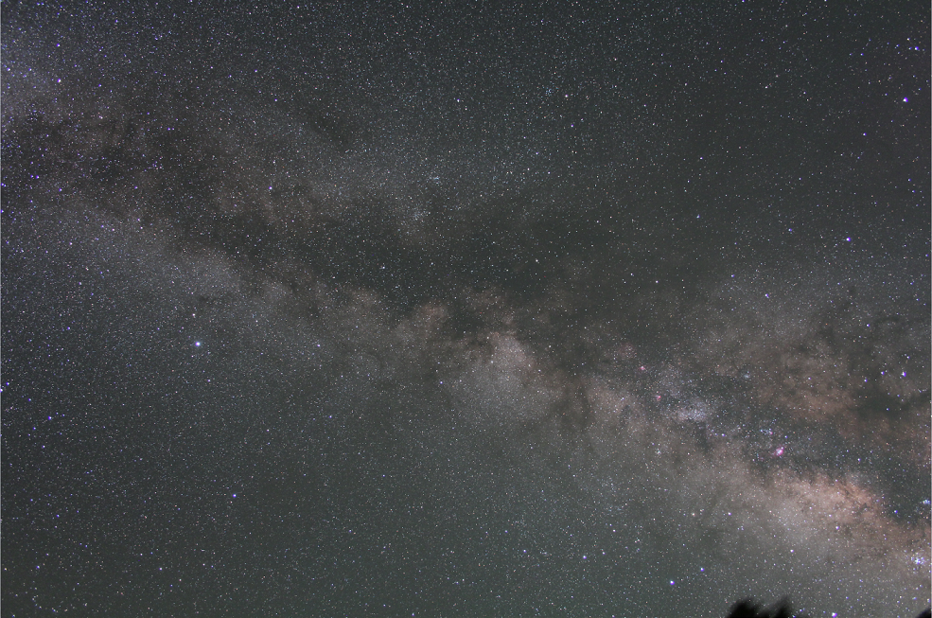
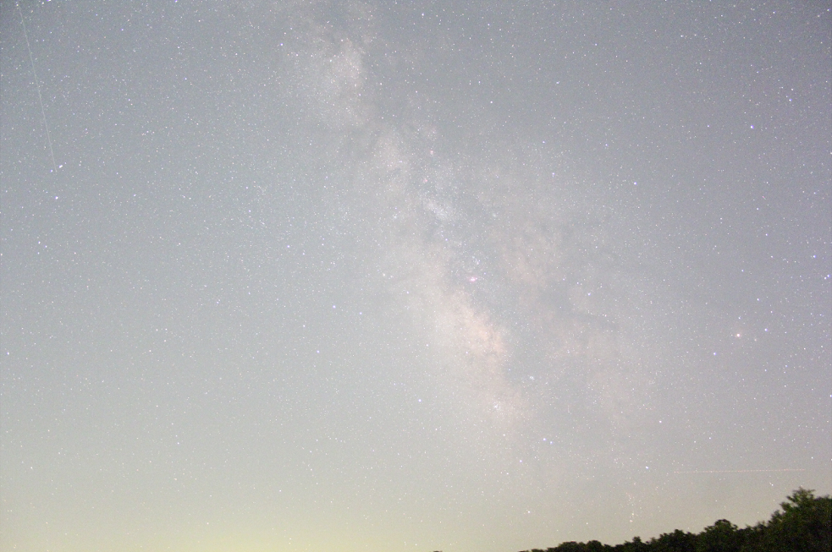
Kirksville, Mo 1 minute exposure, tracking ‘on’
Flagstaff, Az 5 minute exposure, tracking ‘on’

Slide 6
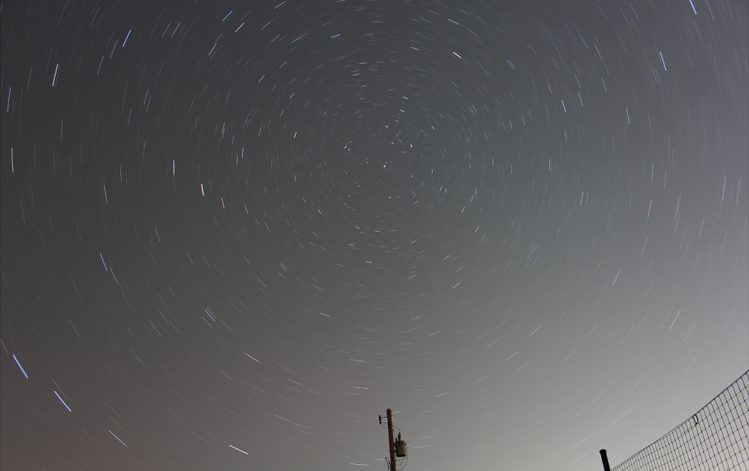
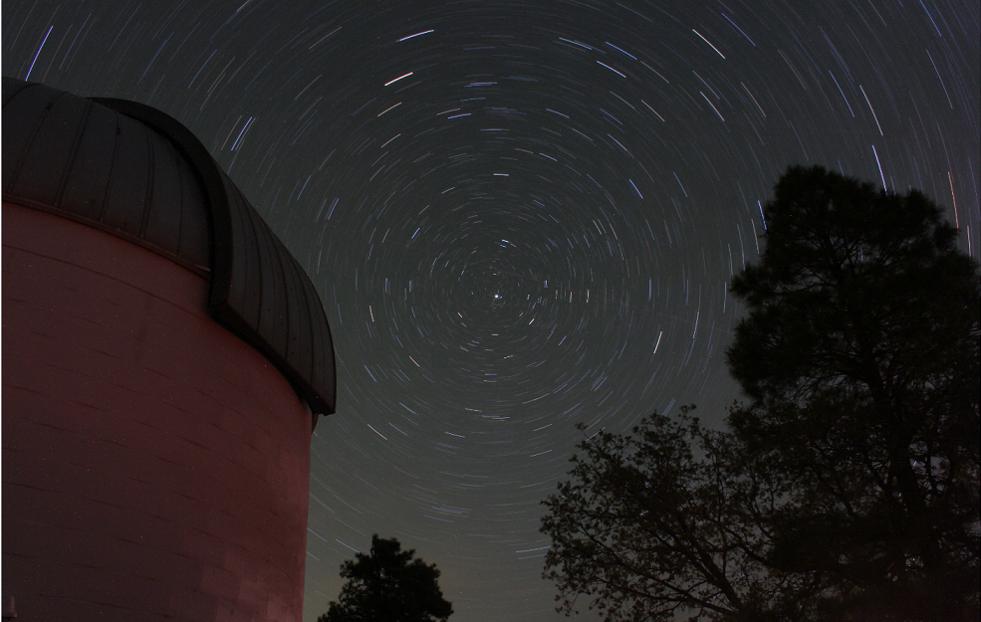
Flagstaff, Az 30 minute exposure, tracking ‘off’
Kirksville, Mo 15 minute exposure, tracking ‘off’

Slide 7
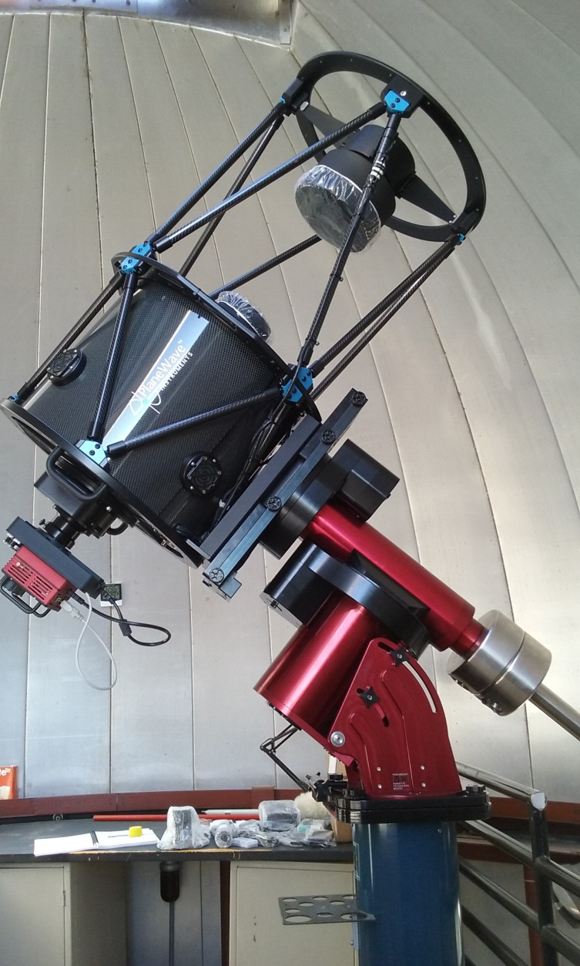
The Truman State Observatory
CDK17 Planewave Telescope
SBIG Aluma 814 & STT-8300 CCD cameras with standard Johnson B,V,R filters
Fully Automated ObservaDome
ACP, TheSky, and Maximdl6 control the observatory, telescope mount, and the CCD camera + guider
Weather Station + Cloud Sensor interfaced with observatory control software

Slide 8
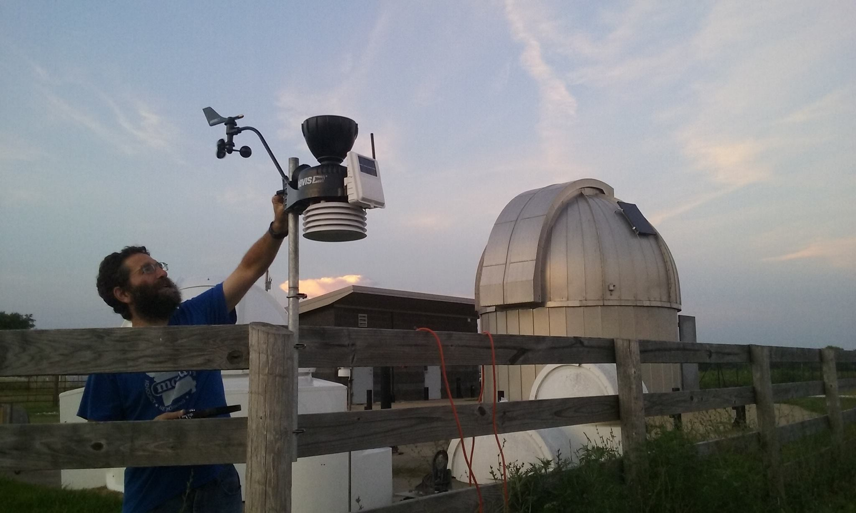
The Weather Station
Davis Instruments 6152 ($750)
Temperature, Humidity, Wind, and Rain sensors
“Talks” wirelessly to observatory control software and overrides “human” commands in case of bad weather
Solar panel
Rain Sensor

Slide 9
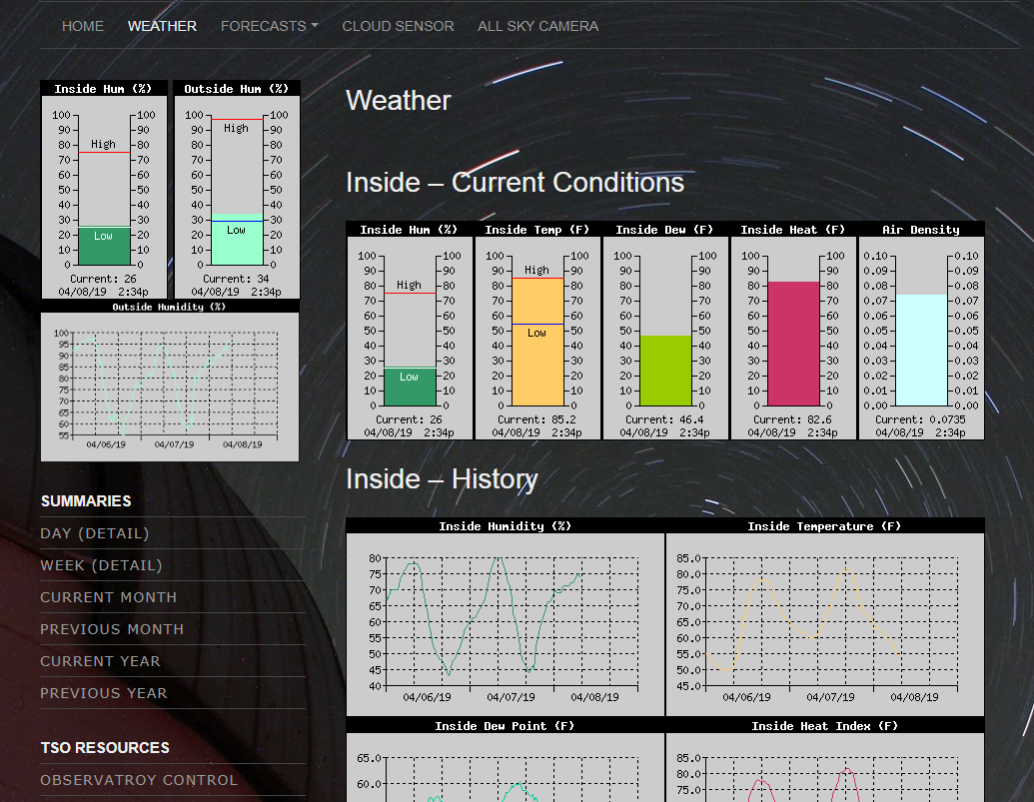
pion.truman.edu (Web interface)

Slide 10
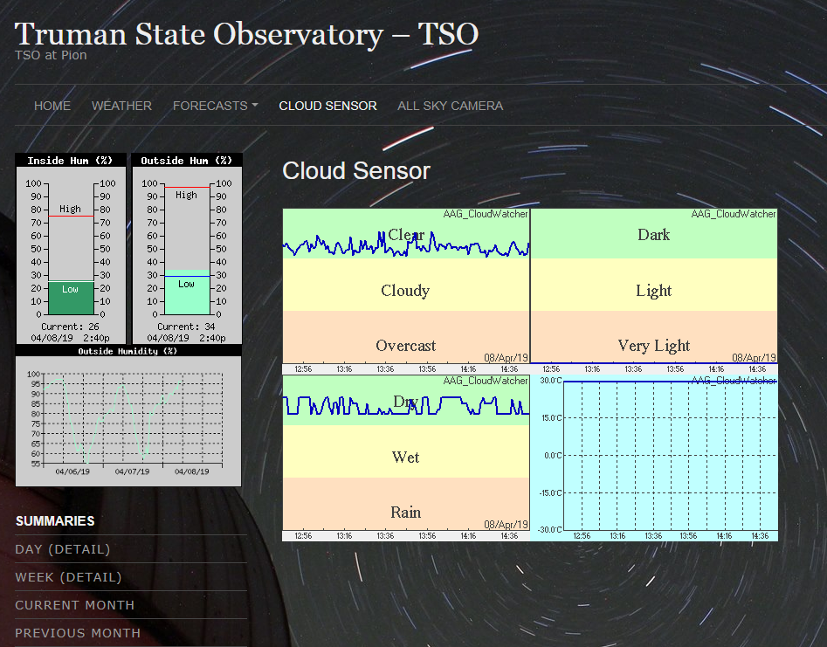
AAG Cloud Sensor ($350)

Slide 11
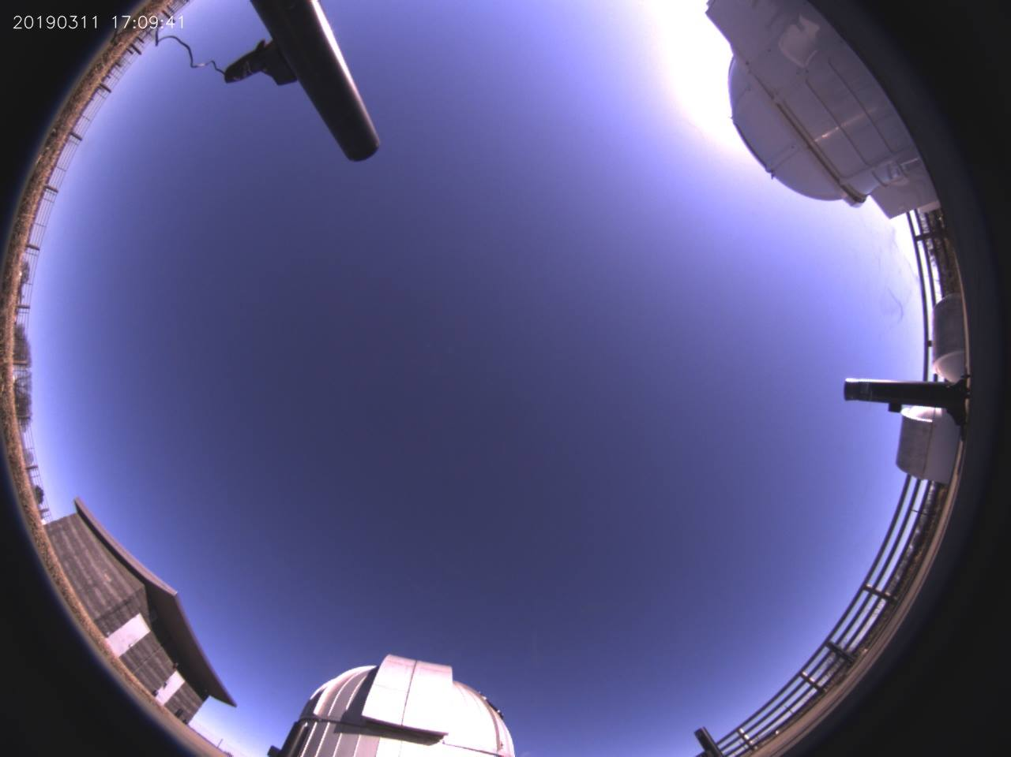
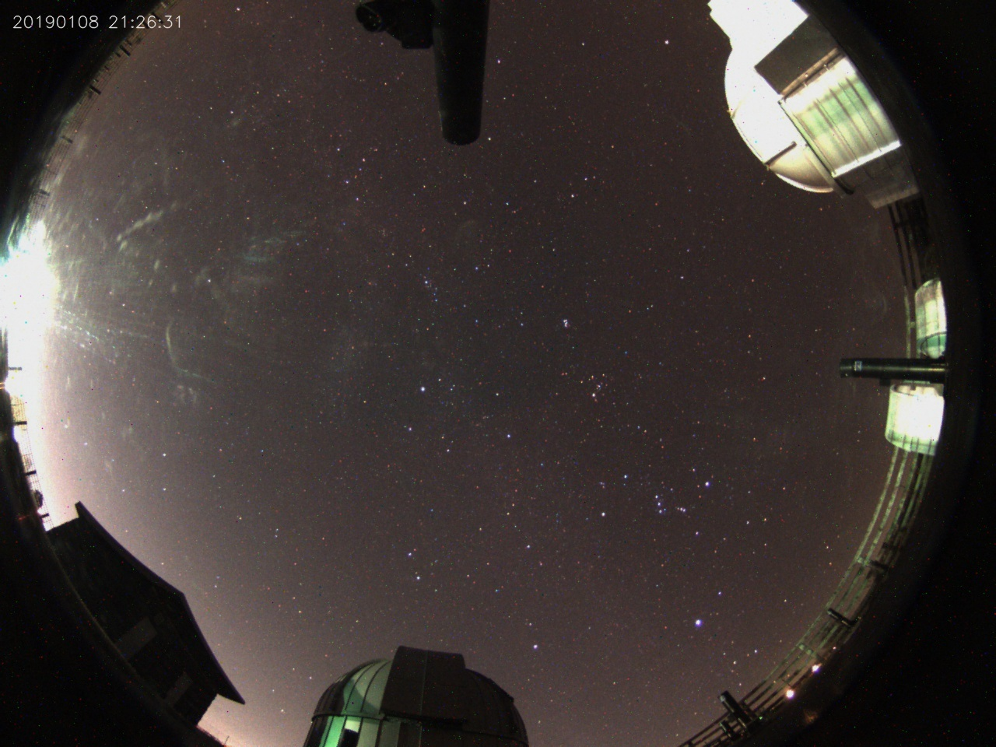
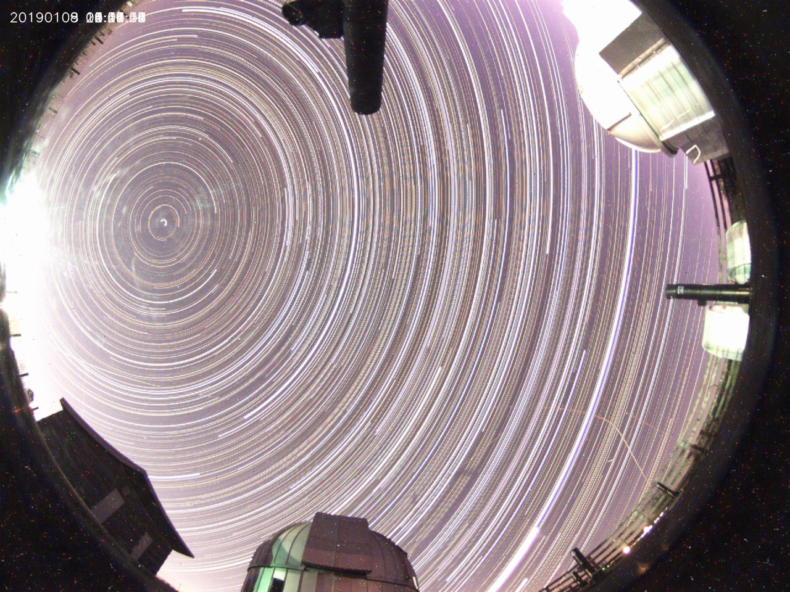
All Sky Camera + Rasp-pi ($150+$100)

Slide 12
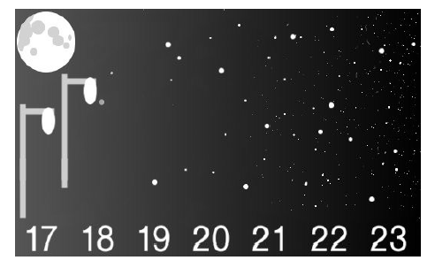
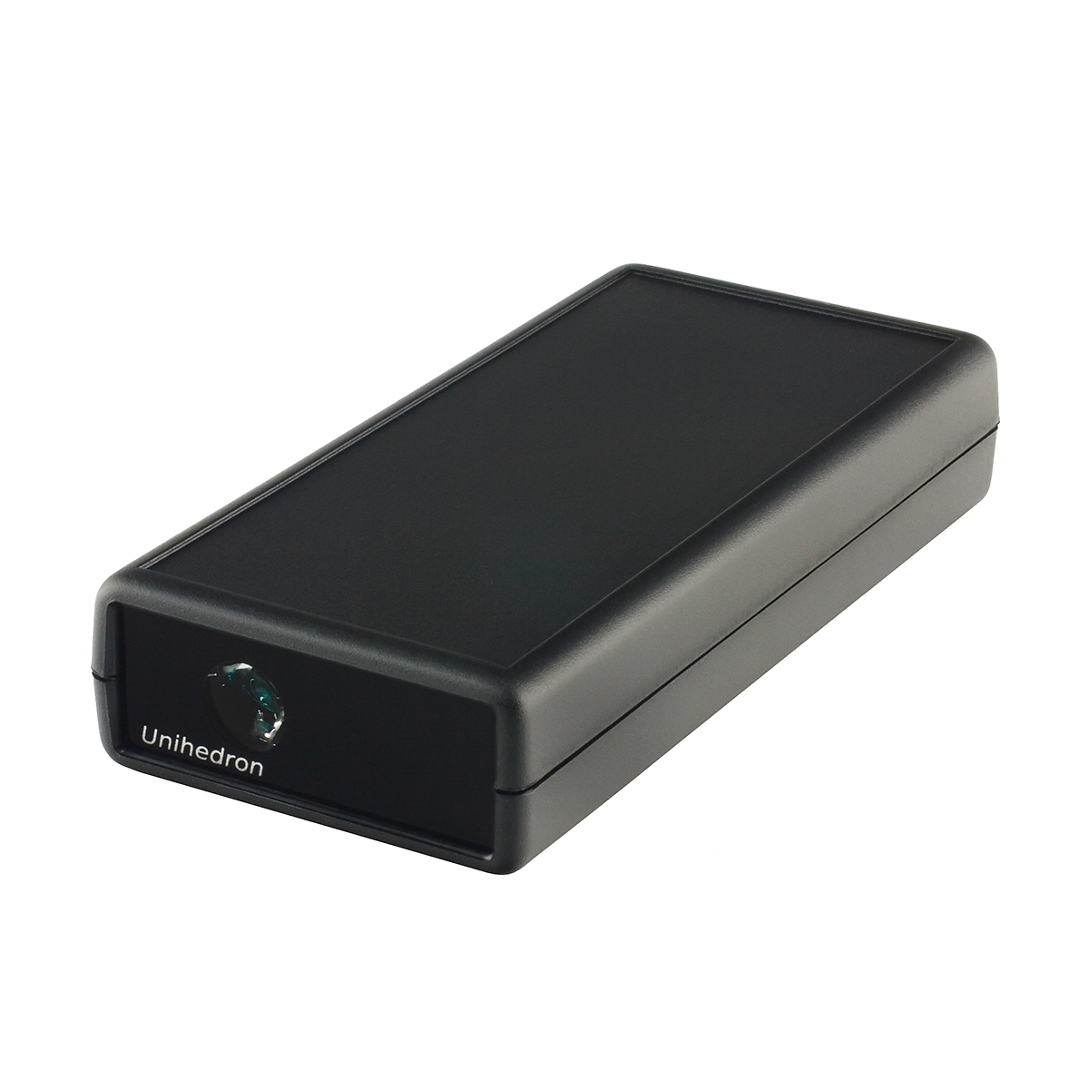
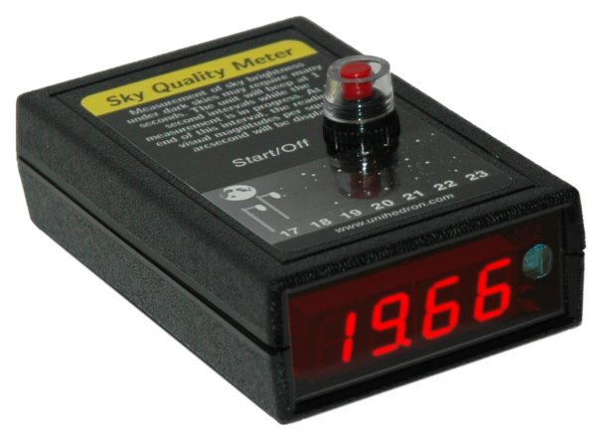
Light Sensors: Sky Quality Meters
SQM (84º) and SQM-L (20º)
Readings in mag/arcsecond²
Higher reading = darker skies

Slide 13
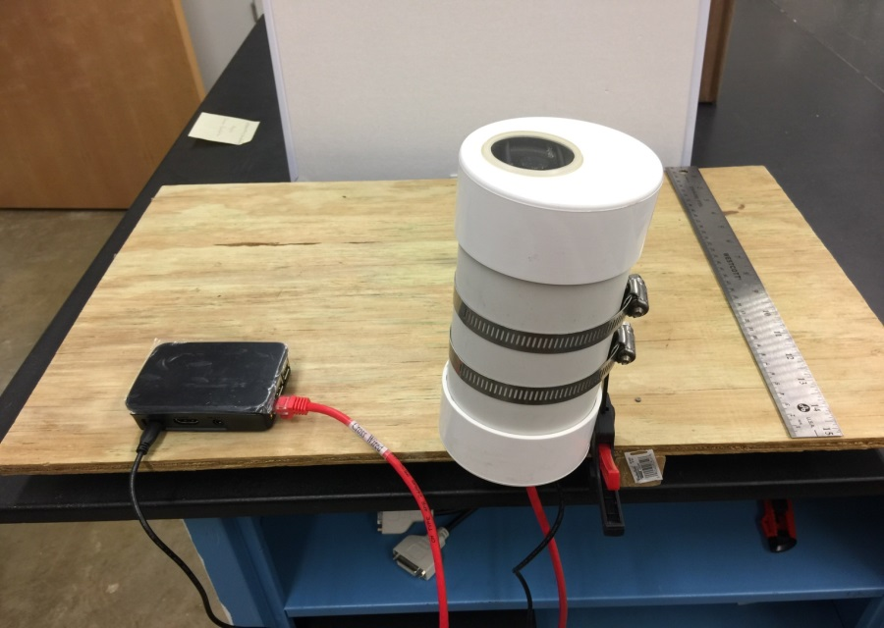
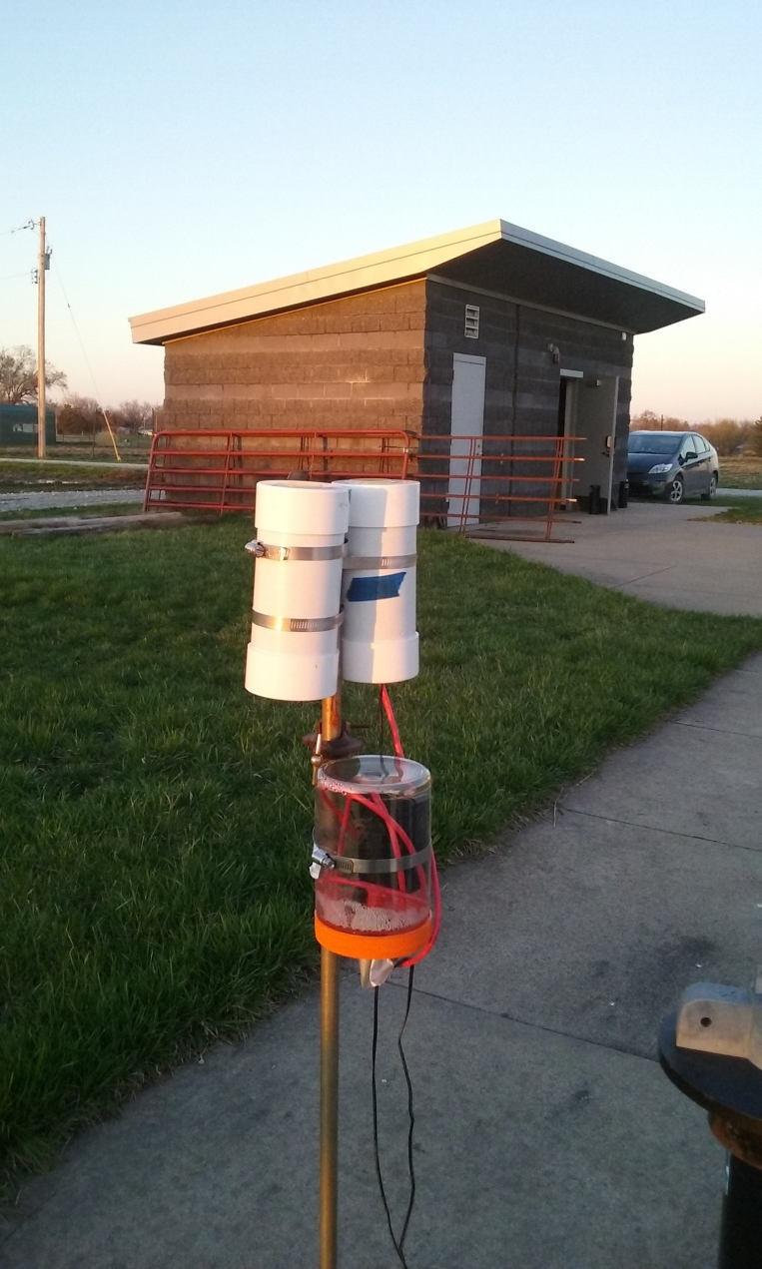
Sky Brightness Measurements
Weather-casing
Clamp
Rasp-pi
Two Types of Installations
“Automatic”: Battery Operated, data retrieval manual (no power supply)
Rasp-Pi Operated: Power supply needed, but data transfer via wireless internet

Slide 14
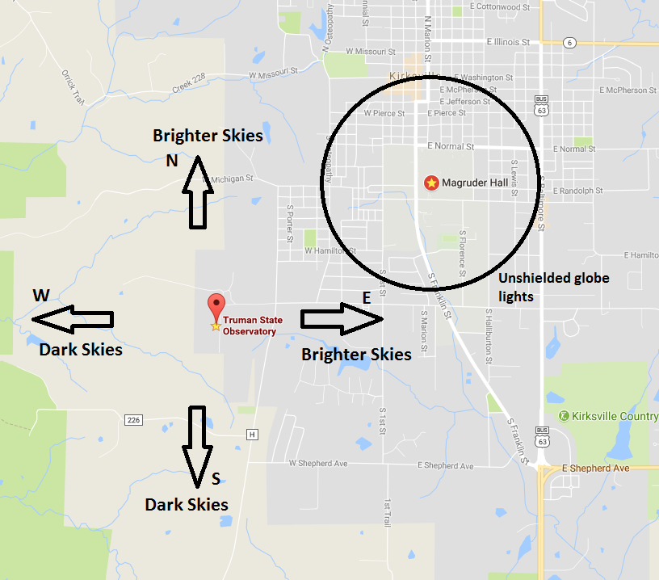
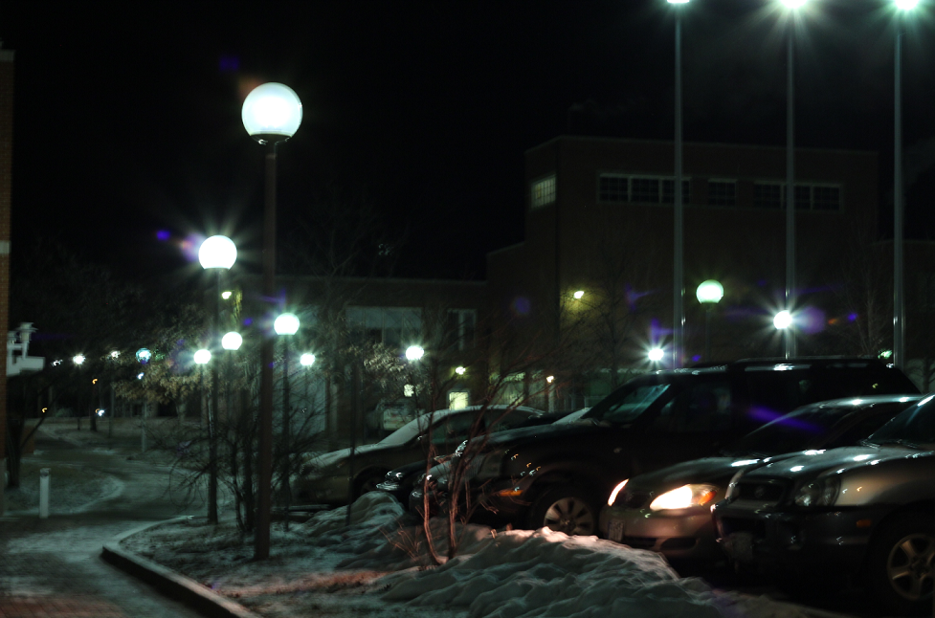
Location: Magruder Roof & TSO

Slide 15
Sky Brightness Measurements
Stadium Lights?

Slide 16
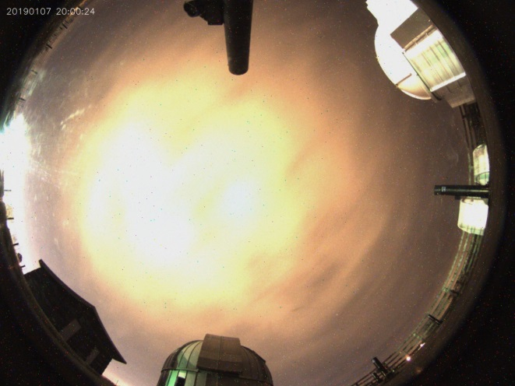
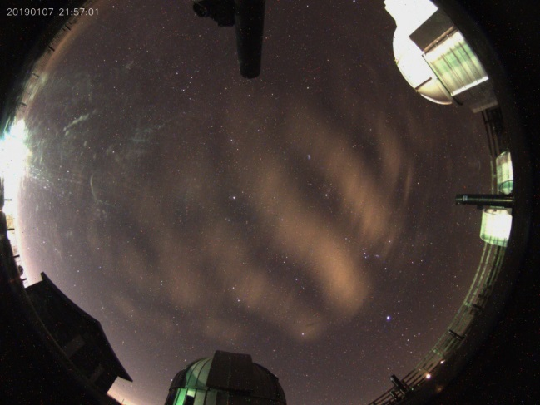
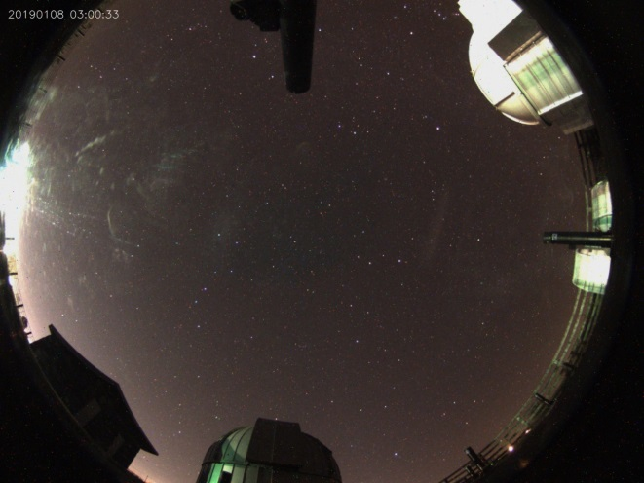
Sky Brightness Measurements
3:00 AM
10:00 PM
8:00 PM

Slide 17
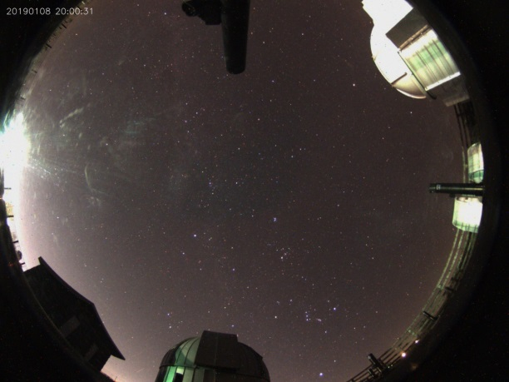
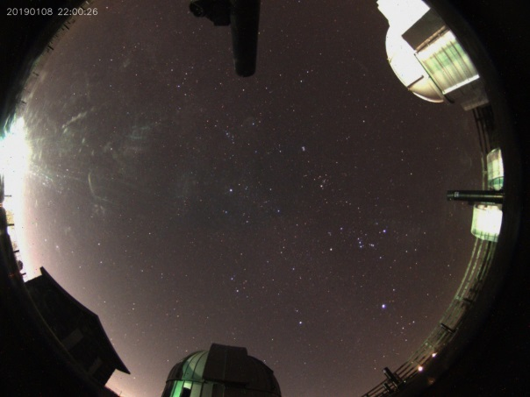
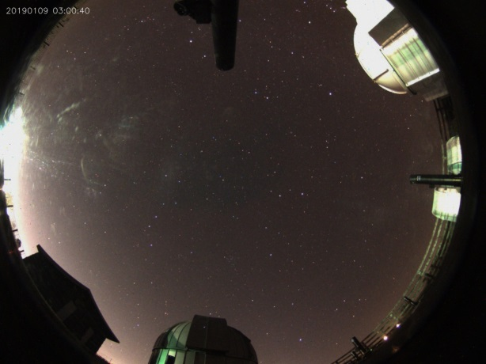
Sky Brightness Measurements
3:00 AM
10:00 PM
8:00 PM

Slide 18
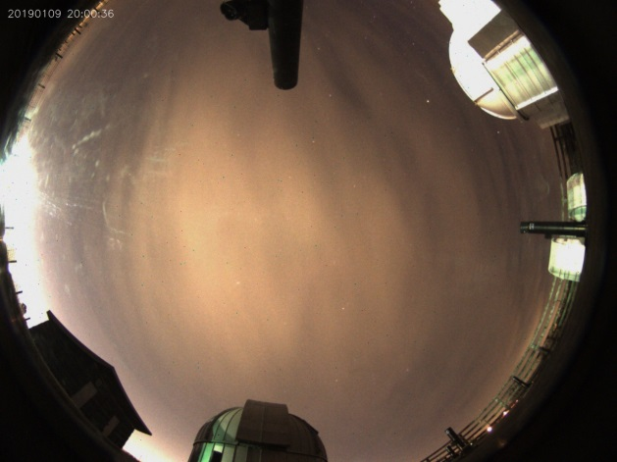
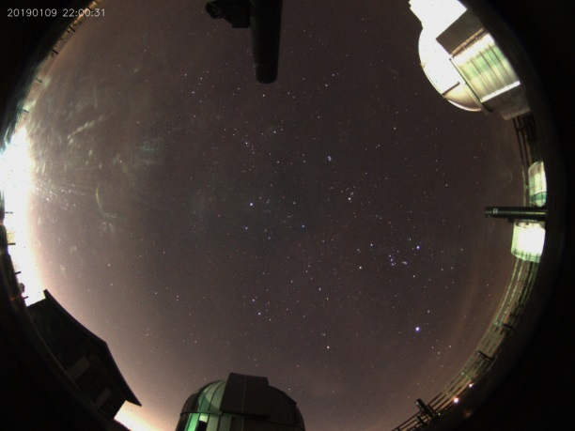
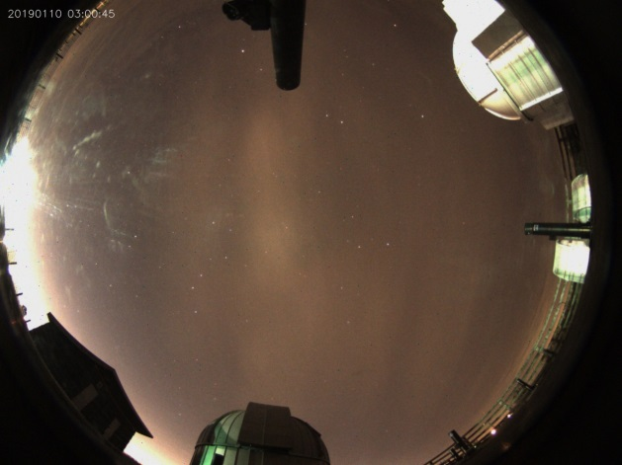
Sky Brightness Measurements
10:00 PM
3:00 AM
8:00 PM

Slide 19
Results and Discussion
The SQM is a easy-to-use and reliable measure of the sky-brightness in semi-rural and urban locations (consistent results obtained over several months of observing).
Cloud cover seems to affect the sky brightness significantly.
We are still investigating the differences in sky brightness as a function of different kinds of clouds: cirrus, stratus, cumulus, etc.
We are also investigating the effect of other weather parameters such as rain, humidity and temperature (preliminary results suggest no obvious correlation).

Slide 20
What can I do?
Future Work
Repeat observations at locations with varying levels of light pollution to establish correlations between sky brightness and local weather conditions
For example, does cloud cover in dark sky locations not affect sky brightness as much as it does in ‘bright-sky locations’?

Slide 21
What can I do?
Future Work
We are looking for collaborators to set up light sensors on campuses to monitor light pollution, and testing the light sensors.
We are installing light shields and changing outdoor lighting color, and will report back what effect these actions have on the sky brightness in Kirksville.
Convince authorities to install smarter lights and retrofit older fixtures with dark-sky shields.
Convince more professional and amateur astronomers to take the lead in this effort before we lose the night sky altogether!

Slide 22
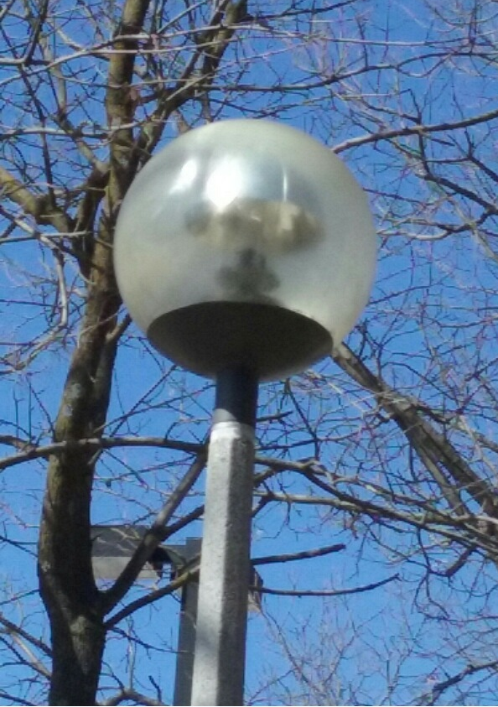
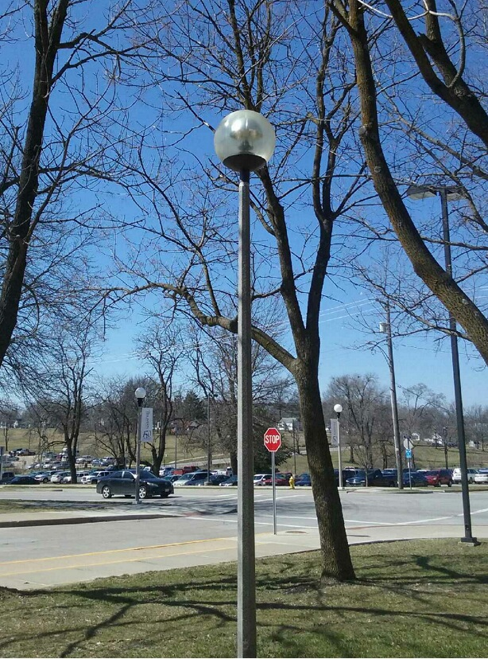
Installing Light Shields & ‘Warmer’ Color Lights

Slide 23
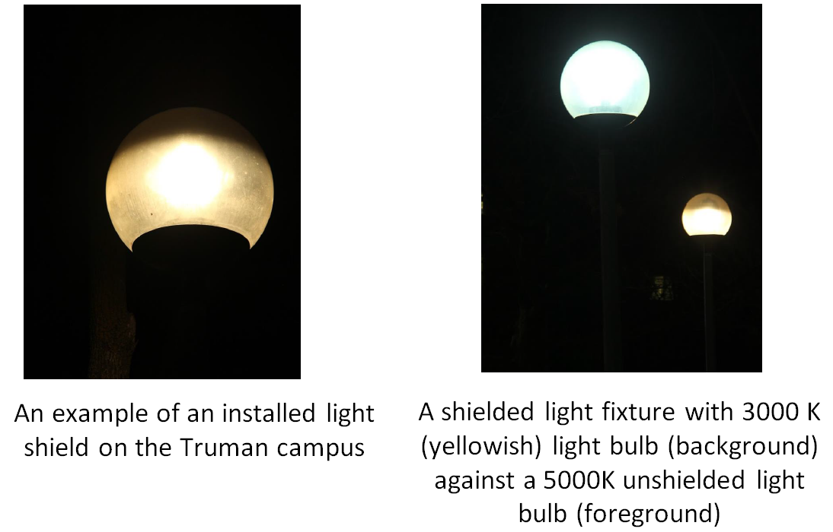
Installing Light Shields & ‘Warmer’ Color Lights

Slide 24
What can I do?
As astronomers, we have to act to stem the growing nuisance of light pollution.
The problem is going to get worse with the growing use of LED lights.
Be proactive about knowing what your school or city is planning in terms of outdoor lighting
Usually, administrators are receptive to our concerns, but tend to be ignorant about issues such as light pollution
Talking to them in time, will have positive impact with favorable outcomes
Urge your graduate and undergraduate students to bring up and pursue this issue through student environmental groups and student government.

Slide 25
References & Sources gokhale@truman.edu
IDA website: http://www.darksky.org/
Losing the dark sky movie: http://www.darksky.org/night-sky-conservation/290
Light Sensor: http://unihedron.com/projects/darksky/index.php
What happened to the Milky Way? http://www.theatlantic.com/video/index/384755/the-night-sky/
Paul Bogard: ‘The End of Night’ (Book) http://www.theatlantic.com/technology/archive/2013/07/let-there-be-night/278070/
Flagstaff Dark Skies: http://www.flagstaffdarkskies.org/
National Parks Service: http://www.nature.nps.gov/night/index.cfm

Slide 26
Extra Slides

Slide 27
Light Pollution
NASA/National Geographic

Slide 28
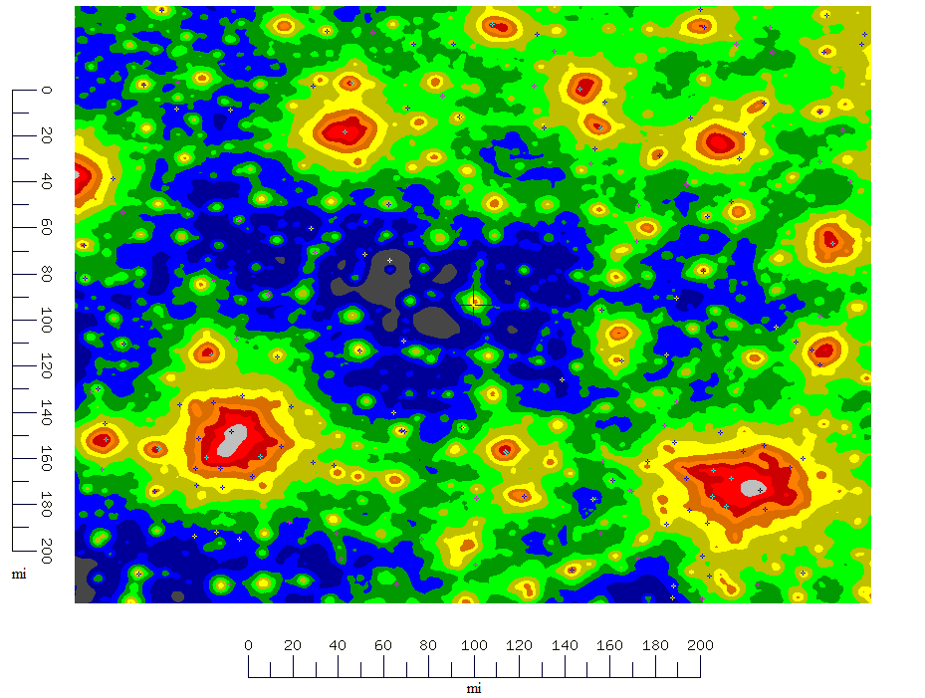
Light Pollution Map
http://www.cleardarksky.com/

Slide 29
Light Pollution is a LOCAL problem with LOCAL solutions

Slide 30
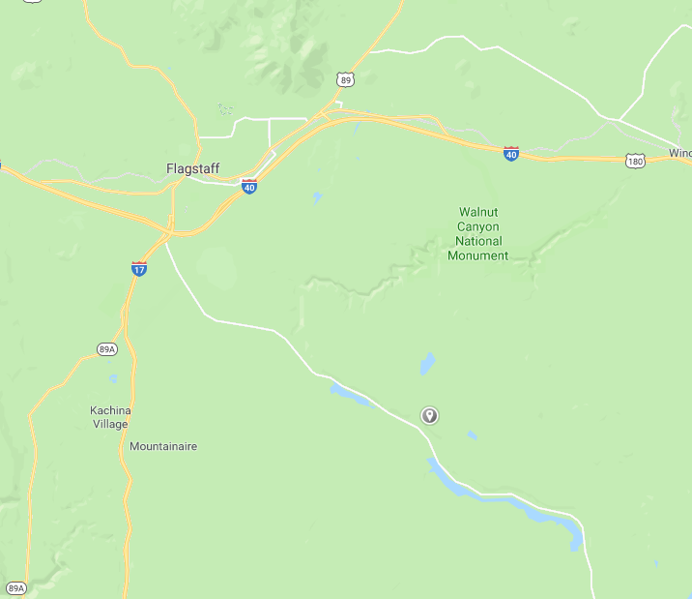
Dark Sky Location: Anderson Mesa
Anderson Mesa

Slide 31
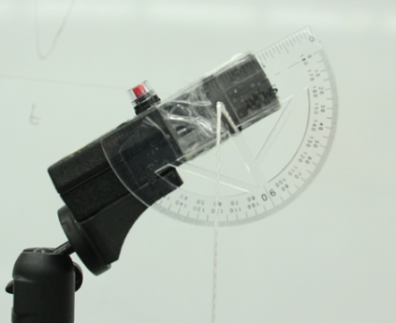
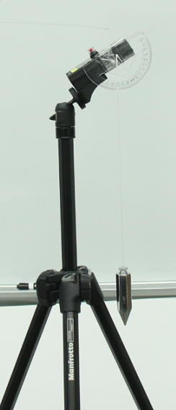
Light Sensor: Set up
The entire set-up cost is less than $400 (for ethernet-sensor)

Slide 32
Sky Brightness with Angle
mags/arcsec²
Horizon
Zenith

Slide 33
Sky Brightness with Angle
mags/arcsec²
Horizon
Zenith

Slide 34
Sky Brightness with Angle
mags/arcsec²
Horizon
Zenith

Slide 35
Sky Brightness with Angle
mags/arcsec²
Horizon
Zenith

Slide 36
Sky Brightness with Angle
mags/arcsec²
Horizon
Zenith

Slide 37
Sky Brightness with Angle
mags/arcsec²
Horizon
Zenith

Slide 38
Sky Brightness with Angle
mags/arcsec²
Horizon
Zenith

Slide 39
Continuous Sky Brightness Readings
mags/arcsec²
time

Slide 40
Continuous Sky Brightness Readings
mags/arcsec²
time

Slide 41
Continuous Sky Brightness Readings
Same Sensors as previous slide (3)
mags/arcsec²
Older Sensors (2)
time
Not sure why there seems to be an offset – requires investigation

Slide 42
Continuous Sky Brightness Readings Kirksville
TSO
mags/arcsec²
Magruder Hall
time

Slide 43
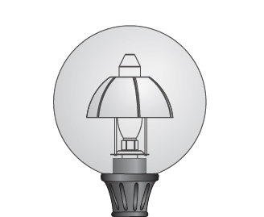
Light Pollution Mitigation
Use low Temperature (T = 3000K) lights
Retrofit ‘dark sky friendly’ shields on ‘unfriendly’ fixtures
Contacting power companies and local administrators to ensure new fixtures are ‘dark sky friendly’
darksky.org

Slide 44
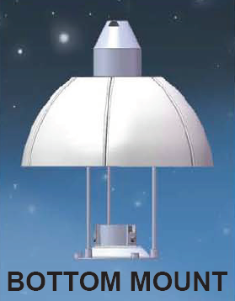
Testing Light Shields

Slide 45
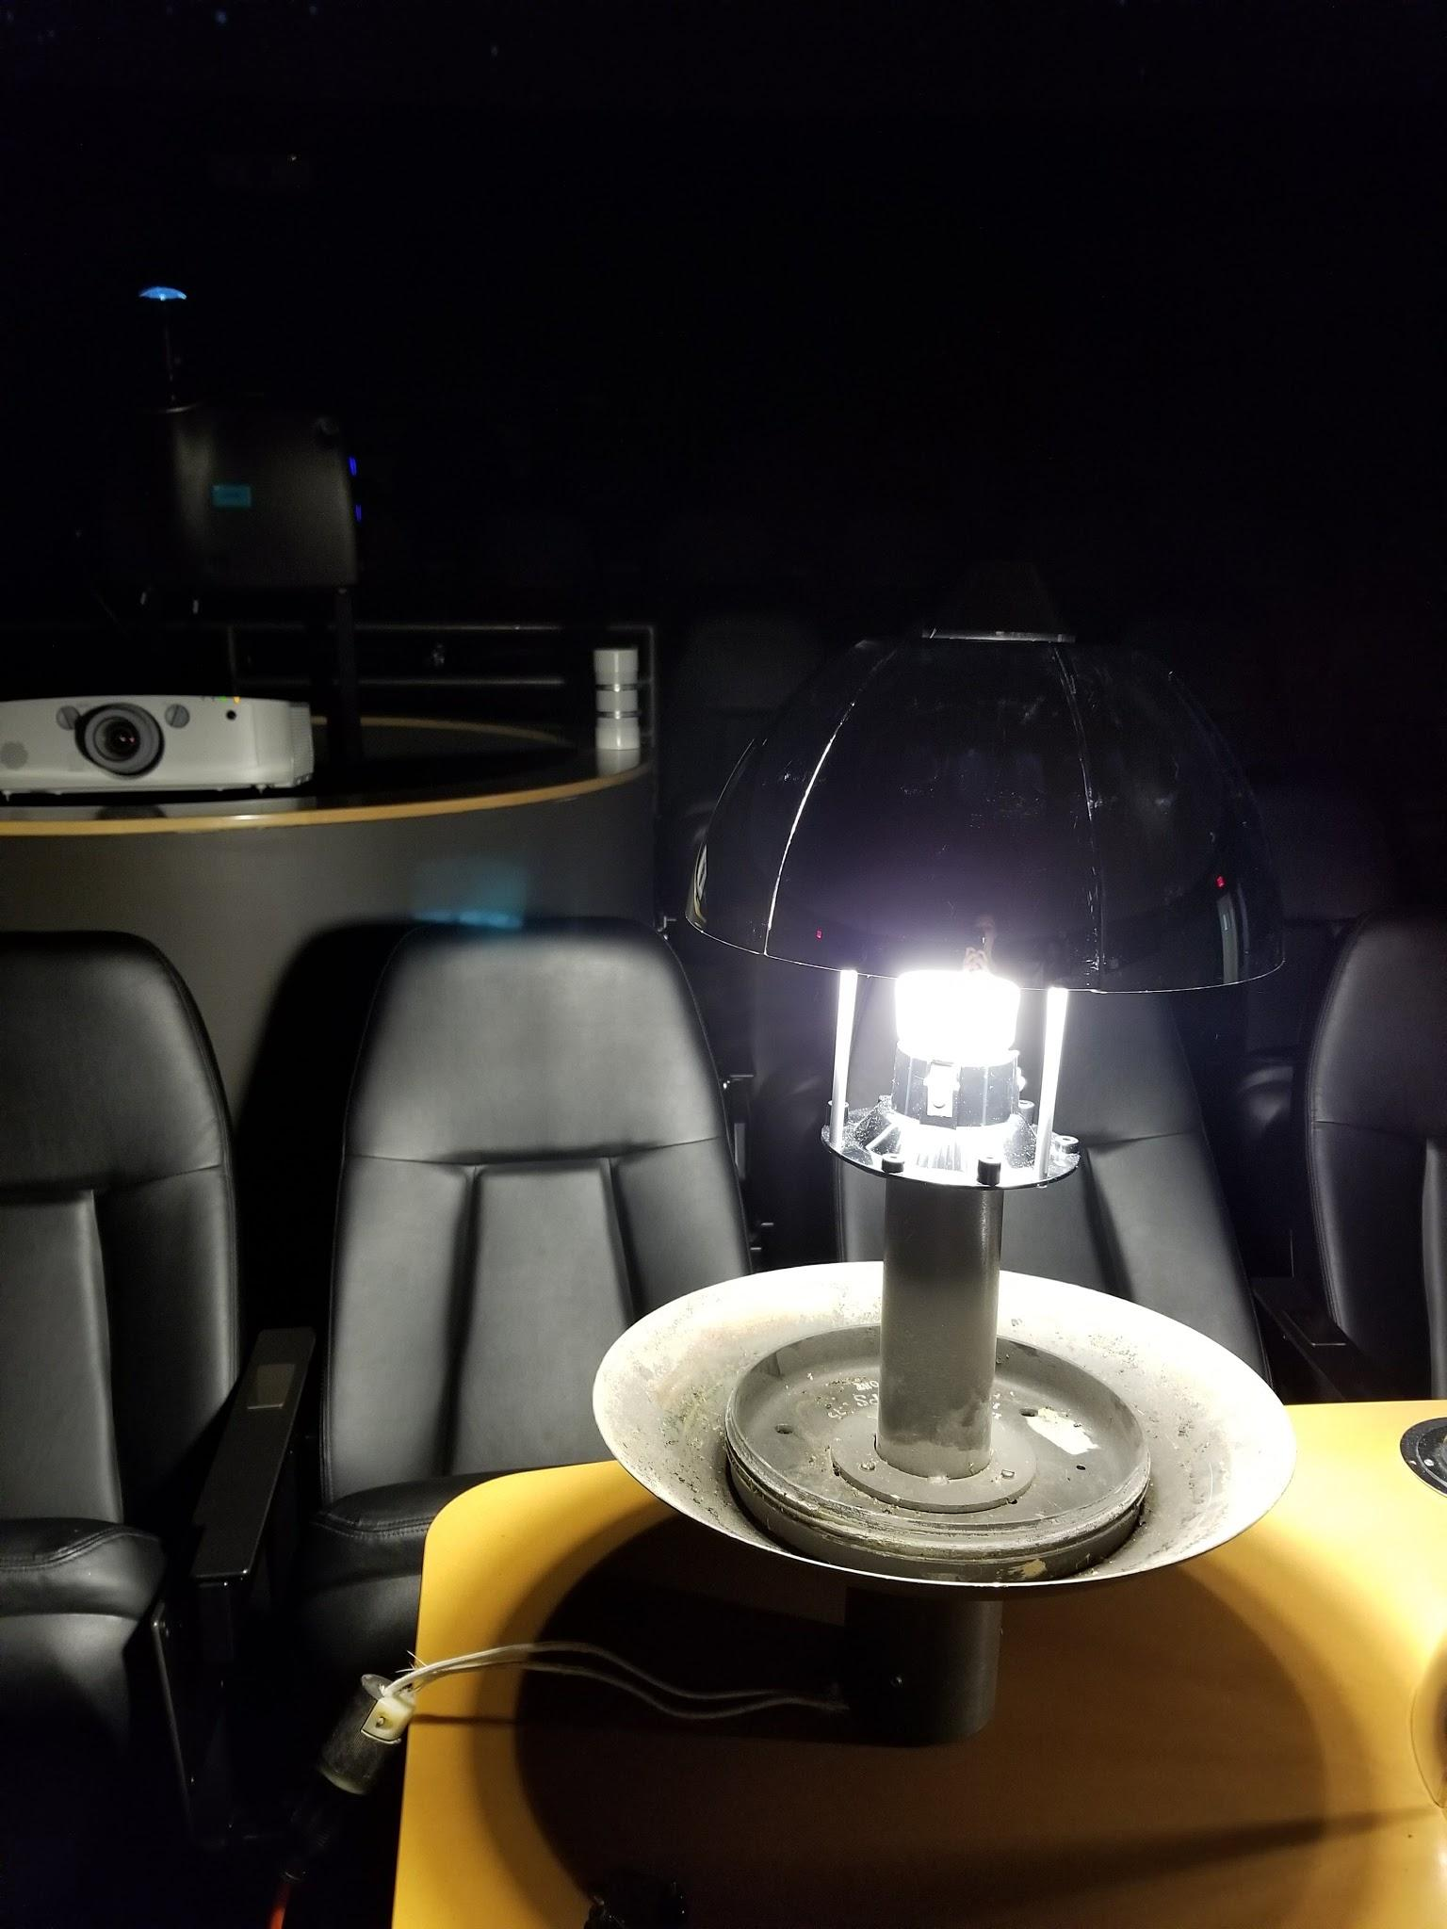
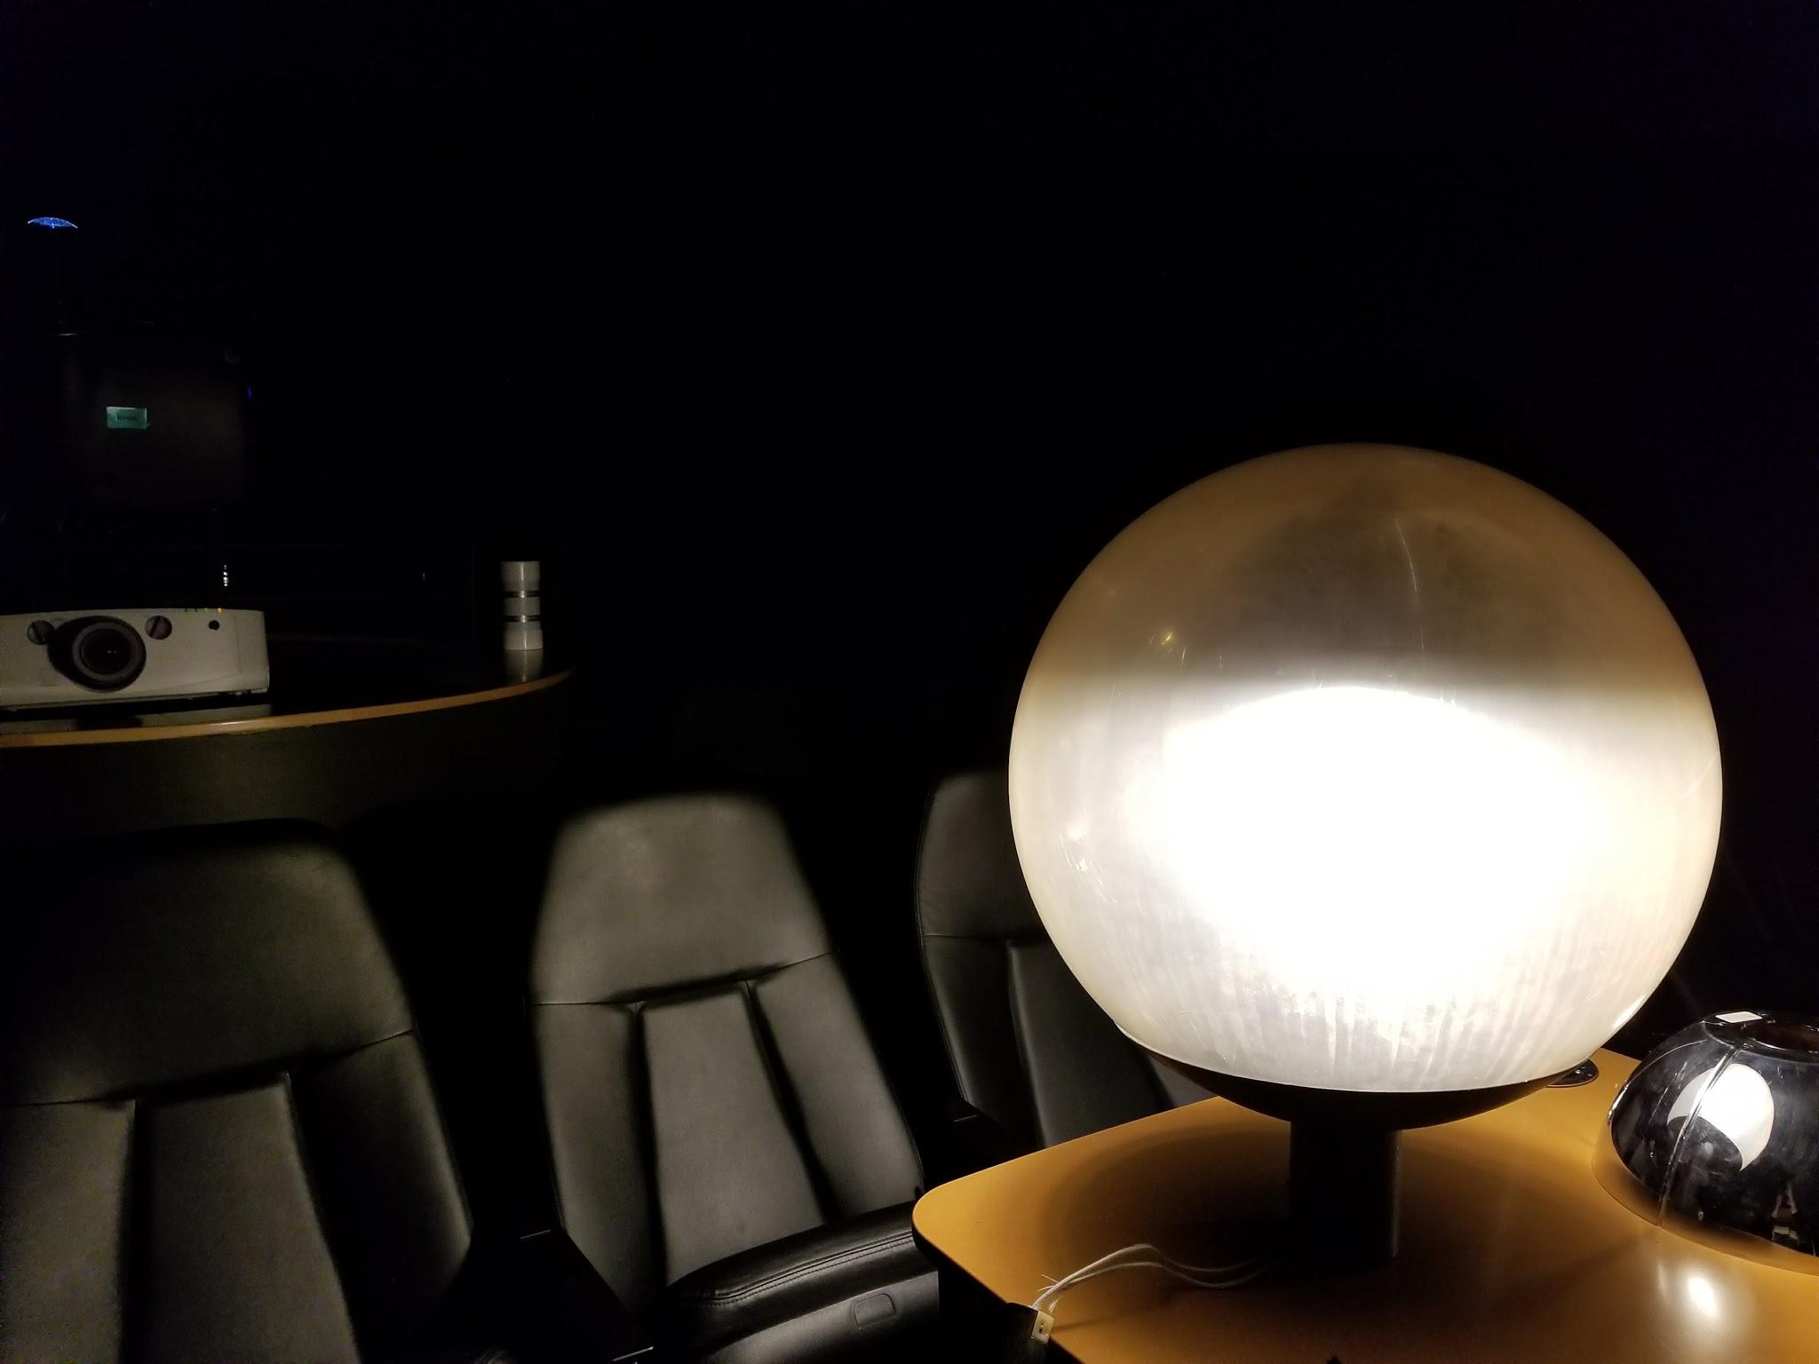
Testing Light Shields
Testing done in Del and Norma Robison Planetarium at Truman

Slide 46
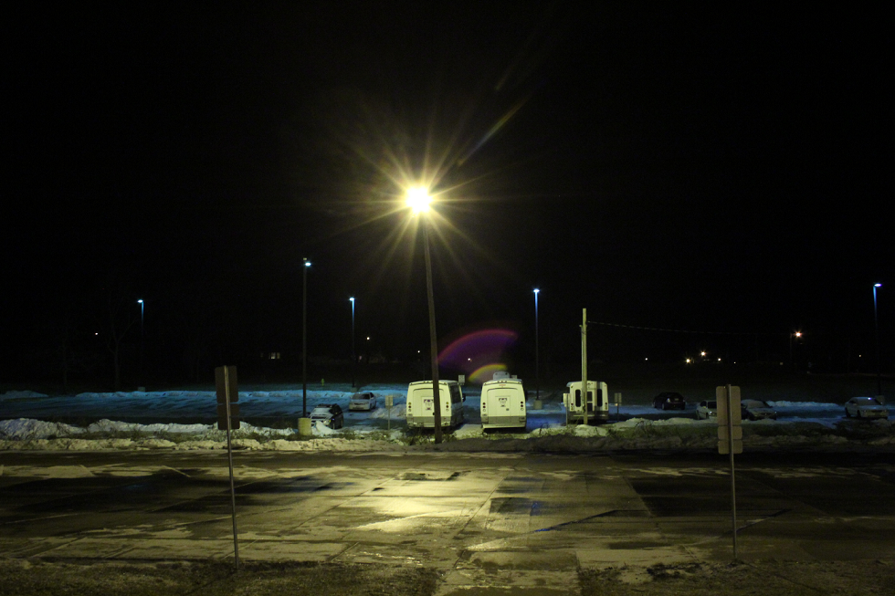
Good and Bad Lighting: Typical Parking lot
Shaming the Admins
Students: You pay for this!

Slide 47
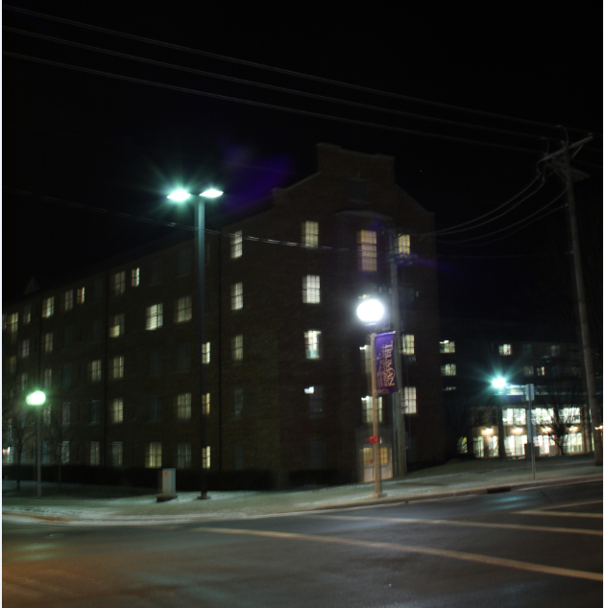
Good
Bad
Notice the light going into the windows in the dorm rooms: Franklin Street

Slide 48
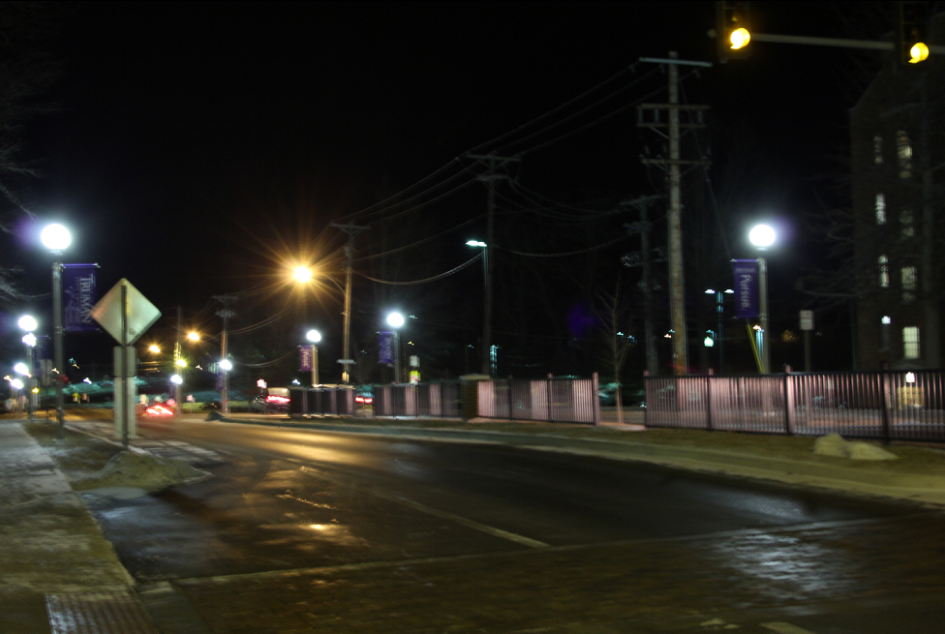
Glare Bombs Galore: Franklin Street

Slide 49
Glare Bombs Galore: Magruder/Violette Parking Lot

Slide 50
Back of Envelope $$ Estimate
A single 100 W bulb costs about $25 to run for 12 hours a day for 365 days a year (@$0.12 per kW-hour).
If approximately 30% of light on average is ‘useless light’, this amounts of about $15 wasted per 100W light bulb.
Assuming 10,000 light fixtures (homes, apt complexes, street lights, gas stations, parking lots, offices, University etc) that are ‘on’ all night; this amounts to $150,000 wasted dollars per year.
And there is additional wastage from excessive indoor lighting as well.
Add to this the environmental impact, and secondary expenses related to health.

Slide 51
Back of Envelope Carbon Footprint Estimate
1 KW-hour corresponds to 10,768 BTU.
4.4 x 10⁶ KW-hour per year is consumed by ten-thousand 50 W bulbs burning 12 hours a day.
This corresponds to 4.74 x 10¹⁰ BTUs, which in turn corresponds to 2370 tons of coal, or 8170 barrels of oil.
If 30% of this is wasted as glare or sky-glow; this corresponds to about 700 tons of coal, or 2500 barrels of oil per year.

Slide 52
What can I do?
http://www.darksky.org/assets/documents/PG3-residential-lighting.pdf

Slide 53
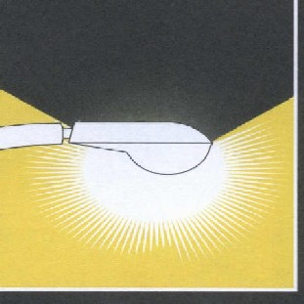
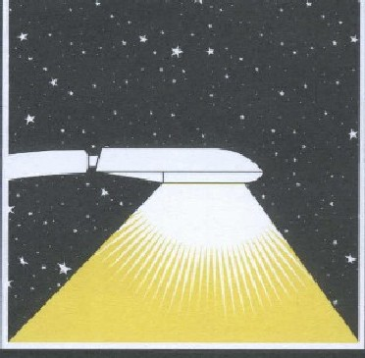
Consequences of Light Pollution
Unshielded light sources
Waste energy
As much as 30% of outdoor lighting is beamed upward, toward the sky, rather than toward the ground.
Are unsafe (very counterintuitive)
Glare from misdirected bright lights can blind you.
The human eye is a remarkable instrument capable of seeing very faint objects.
However, if the brightness ratio between two objects is greater than 20:1; the eye cannot discern objects around the glaring light, rendering us vulnerable to an ambush.

Slide 54
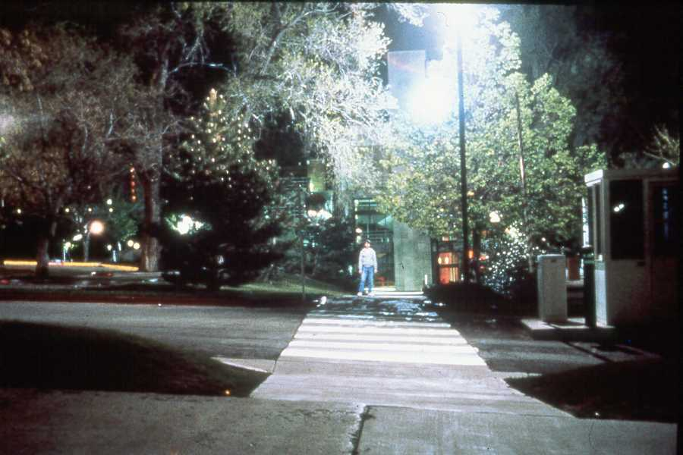
Non-shielded lights are unsafe
The glaring lamp to the right of the path was installed to protect. students at night.
Notes:
Here is an excellent example of a poorly designed lighting scheme and how it does not contribute to campus safety. Notice the glare in the trees? Well the students don’t walk there, but on the ground where they do walk there are lots of shadows.

Slide 55
Where did the student go?
Notes:
Can you detect where the student is now? This light was meant to make the campus safer, but the lighting has only made the shadows easier to hide in. The student is now directly under the lamp, great place for a shadow isn’t it. Now we have created the shadows in which to lurk.

Slide 56
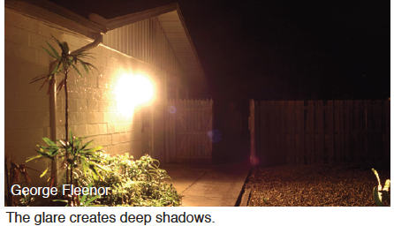
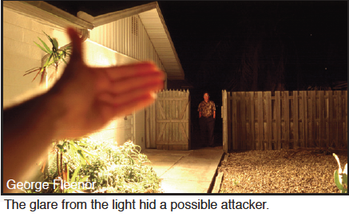
Examples of Bad Lighting

Slide 57
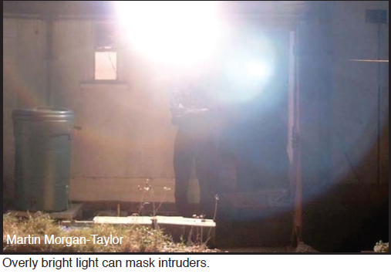
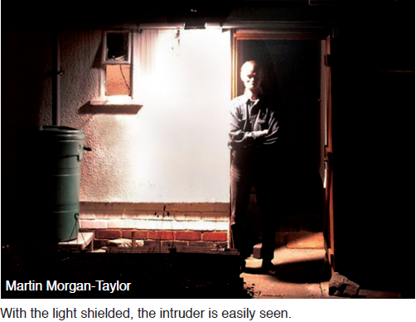
Examples of Bad Lighting

Slide 58
Light Pollution
Unshielded light sources
Negatively impact animals, including humans.
Disturbs Circadian rhythm, resulting in insomnia, depression, cancer and cardio-vascular disease.
The ‘blue’ portion of light is especially harmful since exposure to it affects release of the hormone Melatonin.
In 2009, the AMA adopted resolutions that support reduction of light pollution and glare; and advocate for energy efficient, fully shielded outdoor lighting.

Slide 59
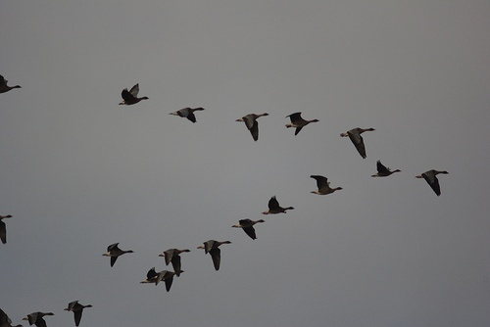
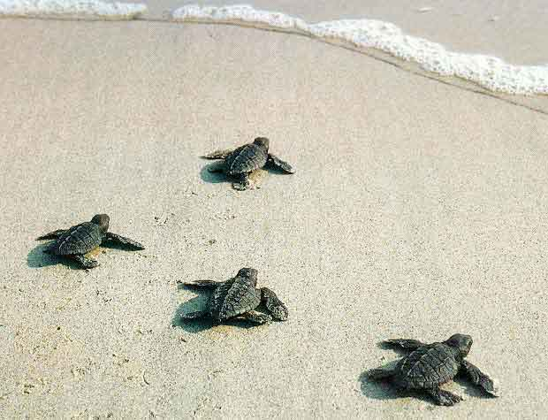
Light Pollution
Unshielded light sources
Negatively impact animals, including humans.
100 million birds a year throughout North America die in collisions with lighted buildings and towers.
Artificial lights can also cause migrating birds to wander off course and never reach their natural destination.

Slide 60
Light Pollution
Unshielded light sources
Negatively impact astronomy
In astronomy, the role of ‘experimentation’ is largely taken by ‘observations’.
These observations are based on light (gamma rays, x-rays, uv, visible, IR, Radio etc) emitted by objects at immense distances from Earth.

Slide 61
Light Pollution
Unshielded light sources
Negatively impact astronomy
It is on the basis of studying the properties of this light that astronomers are able to piece together what the properties of the emitting object are.
Sky glow interferes with astronomers’ ability to look the quality and quantity of light coming from these objects.
Sky glow decreases the ability to see fainter stars, meteor showers and nebulae; and thus affects stargazing and amateur astronomy.

Slide 62
What can I do?
Pima County, which includes Tucson, has the following ‘light ordinance’ in effect: The purpose of this code is to preserve the relationship of the residents of the City of Tucson, Arizona and Pima County, Arizona to their unique desert environment through protection of access to the dark night sky. Intended outcomes include continuing support of astronomical activity and minimizing wasted energy, while not compromising the safety, security, and well being of persons engaged in outdoor night time activities. It is the intent of this code to control the obtrusive aspects of excessive and careless outdoor lighting usage while preserving, protecting, and enhancing the lawful nighttime use and enjoyment of any and all property. It is recognized that developed portions of properties may be required to be unlit, covered, or have reduced lighting levels in order to allow enough lumens in the lighted areas to achieve light levels in accordance with nationally recognized recommended practices.
http://webcms.pima.gov/UserFiles/Servers/Server_6/File/Government/Development%20Services/Building/OLC.pdf

